Slide 1
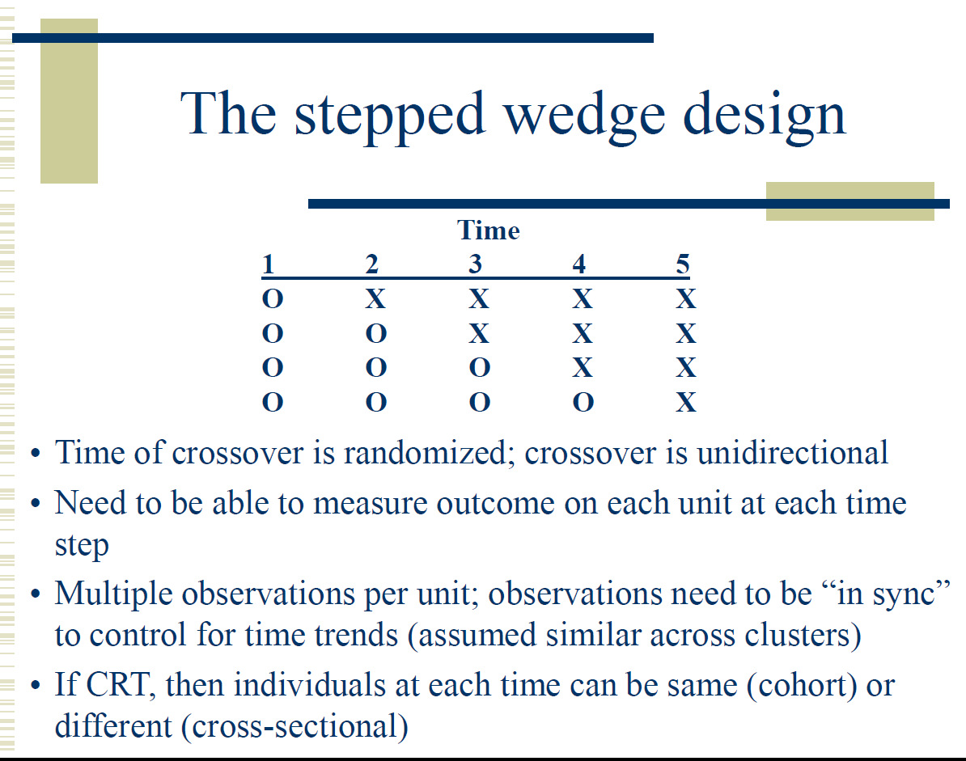
Stepped Wedge Designs

Slide 2
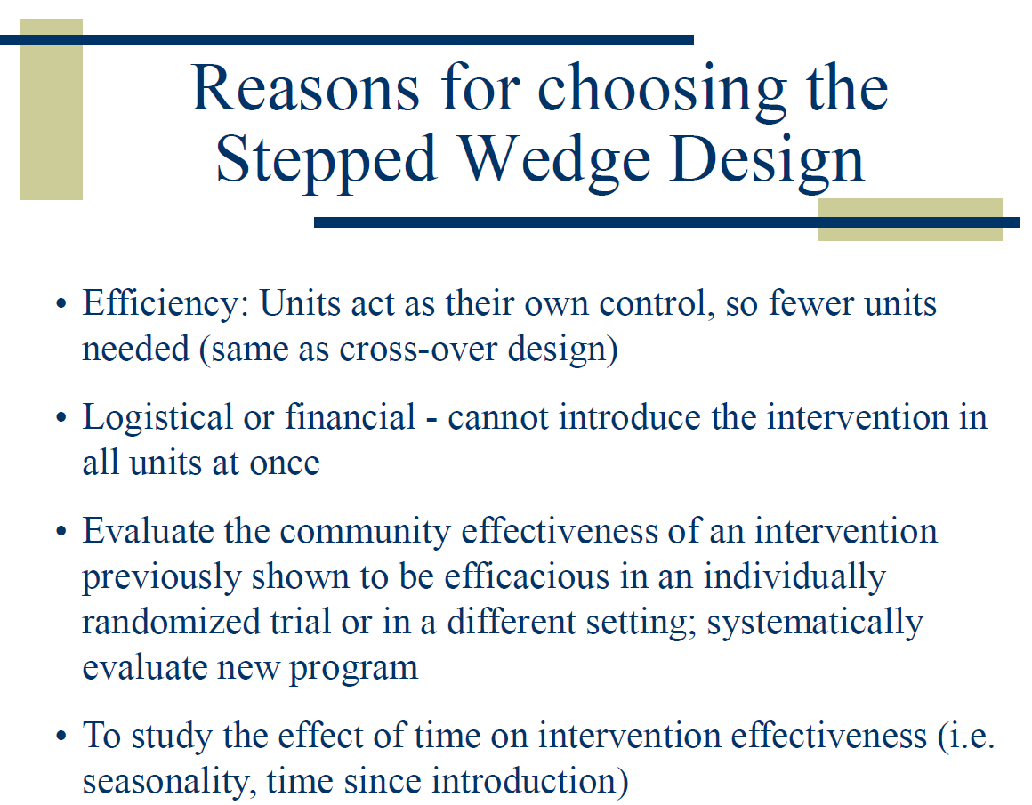

Slide 3
Expedited partner treatment in Washington
A stepped-wedge rollout across 24 counties
Treatment
Expedited partner treatment (EPT) treats partners of people with
gonorrhea or chlamydia to help prevent reinfection.
Evidence
A University of Washington project found that EPT reduced
reinfection in an individually randomized trial (Golden et al., 2005).
Rollout
Logistical challenges require staggered implementation.
The stepped-wedge design randomizes 24 counties to start times,
with 6 counties starting each period.
Assessment
Each 6-month period includes 3 months for implementation and
3 to assess sexually transmitted infection outcomes at sentinel sites
(selected sites that monitor infection rates).
Reference: Golden and colleagues (2005), New England Journal of Medicine 352:676–685
Notes:
Source content: user-supplied slide image. The rollout numbers and timing reproduce the teaching example, not an updated implementation protocol. IRT is interpreted as individually randomized trial, consistent with the cited study. Gc refers to gonococcus, Neisseria gonorrhoeae. EPT is also commonly called expedited partner therapy. Reference: Golden MR et al. Effect of Expedited Treatment of Sex Partners on Recurrent or Persistent Gonorrhea or Chlamydial Infection. 2005. https://www.nejm.org/doi/abs/10.1056/NEJMoa041681

Slide 4
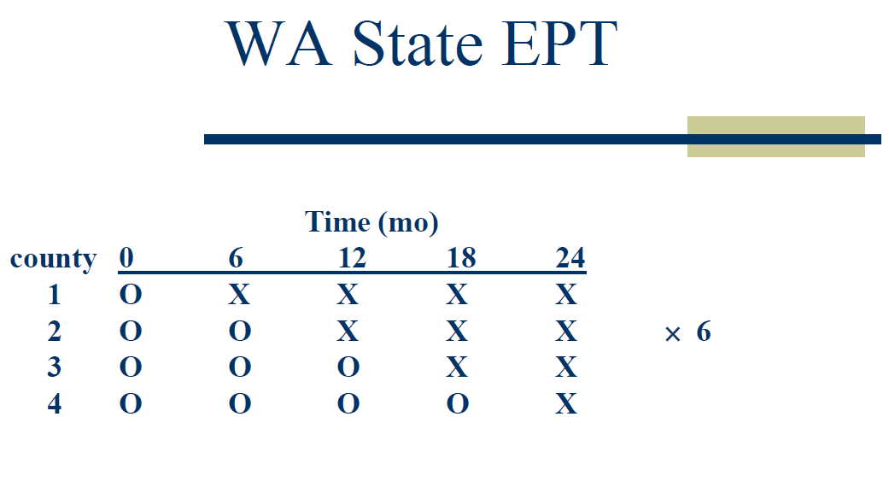
Notes:
Add MaxART; add FIGO

Slide 5
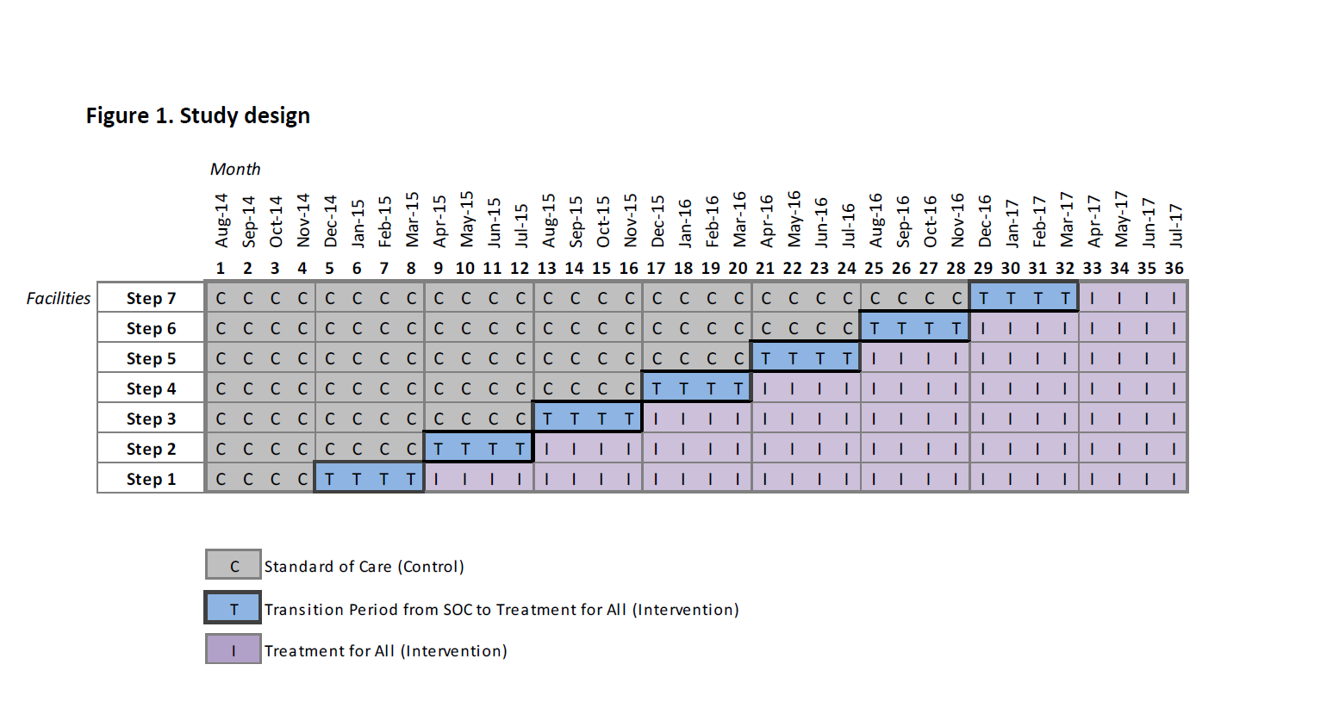
Early Access to ART in Swaziland,
CHAI (MaxART)
Khan, S., Spiegelman, D., Walsh, F., Mazibuko, S., Pasipamire, M., Chai, B., Reis, R., Mlambo, K., Delva, W., Khumalo, G., Zwane, M., Fleming, Y., Mafara, E., Hettema, A., Lejeune, C., Chao, A., Bärnighausen, T. and Okello, V. Early access to antiretroviral therapy versus standard of care among HIV-positive participants in Eswatini in the public health sector: the MaxART stepped-wedge randomized controlled trial. J Int AIDS Soc. 2020; 23(9):e25610

Slide 6
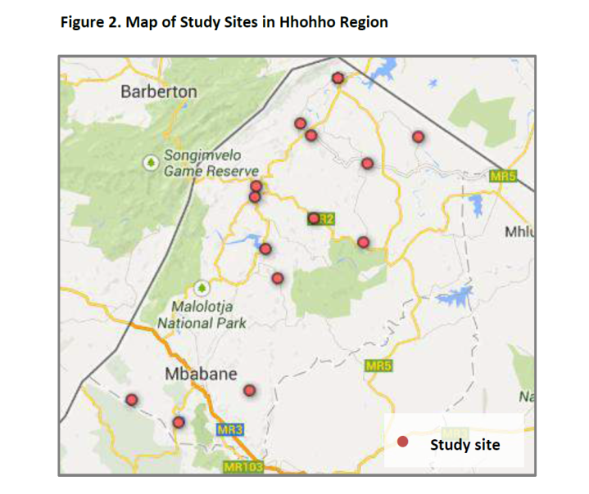
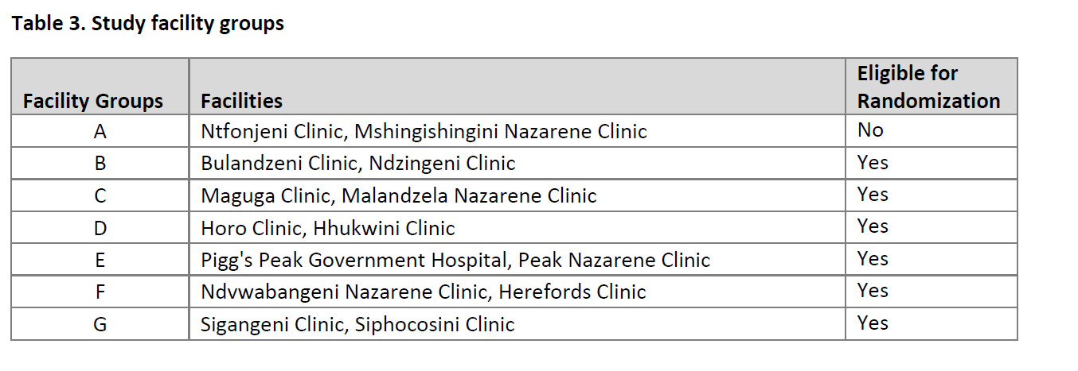
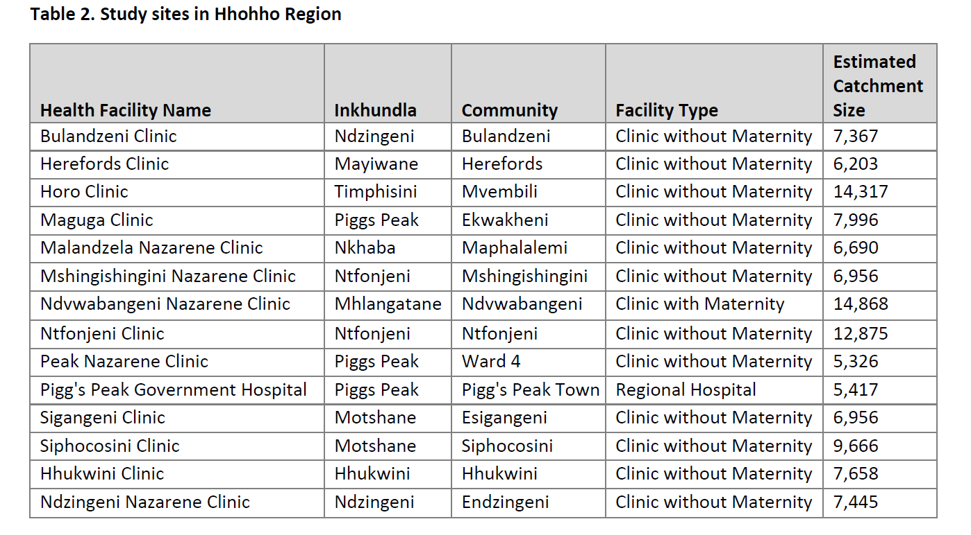

Slide 7
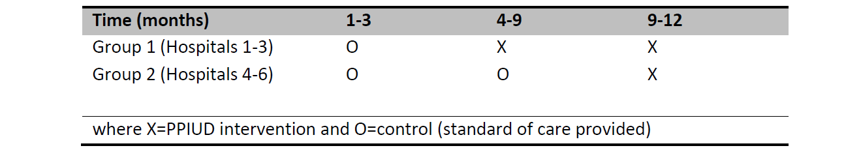
FIGO/PPIUD in Sri Lanka, Nepal, Tanzania
Canning D, Shah I, Pearson E, Pradhan E, Karra M, Senderowicz L, Bärnighausen T, Spiegelman D, Langer A. Institutionalizing postpartum intrauterine device (IUD) services in Sri Lanka, Tanzania, and Nepal: study protocol for a cluster-randomized stepped-wedge trial. BMC Pregnancy and Childbirth 2016.

Slide 8
Types of SWDs
In cross-sectional SWDs, every cluster-time has new participants.
  Cross-sectional in this context does not mean that the intervention and outcome are measured at the same time, as the term would be used in epidemiology
  FIGO is a cross-sectional SWD
In longitudinal or cohort SWDs, the same participants may appear in multiple times within a cluster
  MaxART is a longitudinal SWD
  Longitudinal SWDs have complex correlation structures with at least two levels of clustering, within-participant and within-cluster
Logistics and the nature of the outcome will determine whether a SWD is cross-sectional or longitudinal
  E.g. a pregnancy outcome lends itself to a cross-sectional SWD design, while a CD4 or viral load trajectory outcome lends itself to a longitudinal SWD design
The SWD is a type of crossover design, where the crossing over is only in one direction, from control to intervention

Slide 9
Power in SWDs
Increases with increasing sample size (number of clusters, number of people within clusters)
Increases with increasing effect size
Decreases with increasing ICC but only slightly
Increases with increasing number of steps

Slide 10
Stepped wedge designs are useful for “phase IV” trials, to evaluate the effect of time on the intervention, and as a way of dealing with logistical difficulties of implementing an intervention everywhere at once
Intervals should be long enough to capture the full treatment effect for sustained exposures, or a point exposure is necessary (e.g. PPIUD insertion after delivery)
There may be an issue with the causal interpretation of cohort SWDs with sustained exposures due to survivor bias. (Open area for more research)

Slide 11
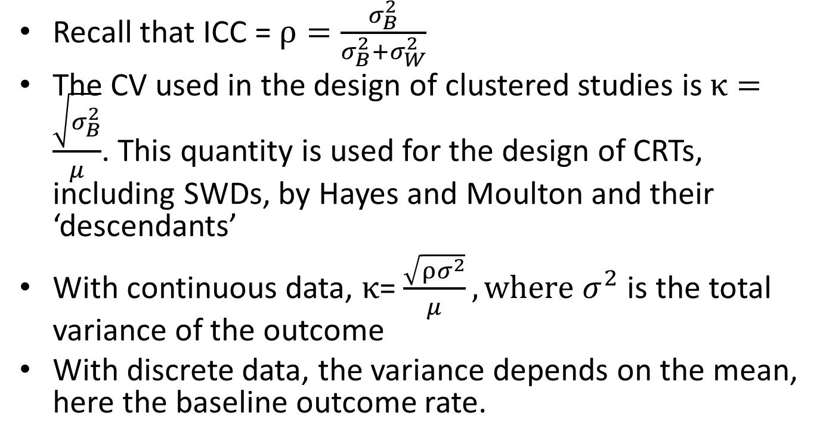
Relationship between ICC (ρ) and CV (κ)
Recall that ICC = $ρ=\frac{σ_{B}^{2}}{σ_{B}^{2}+σ_{W}^{2}}$
The CV used in the design of clustered studies is $κ=\frac{\sqrt{σ_{B}^{2}}}{μ}$. This quantity is used for the design of CRTs, including SWDs, by Hayes and Moulton and their ‘descendants’
With continuous data, $κ$= $\frac{\sqrt{{ρσ}^{2}}}{μ}, where σ^{2}$ is the total variance of the outcome
With discrete data, the variance depends on the mean, here the baseline outcome rate.

Slide 12
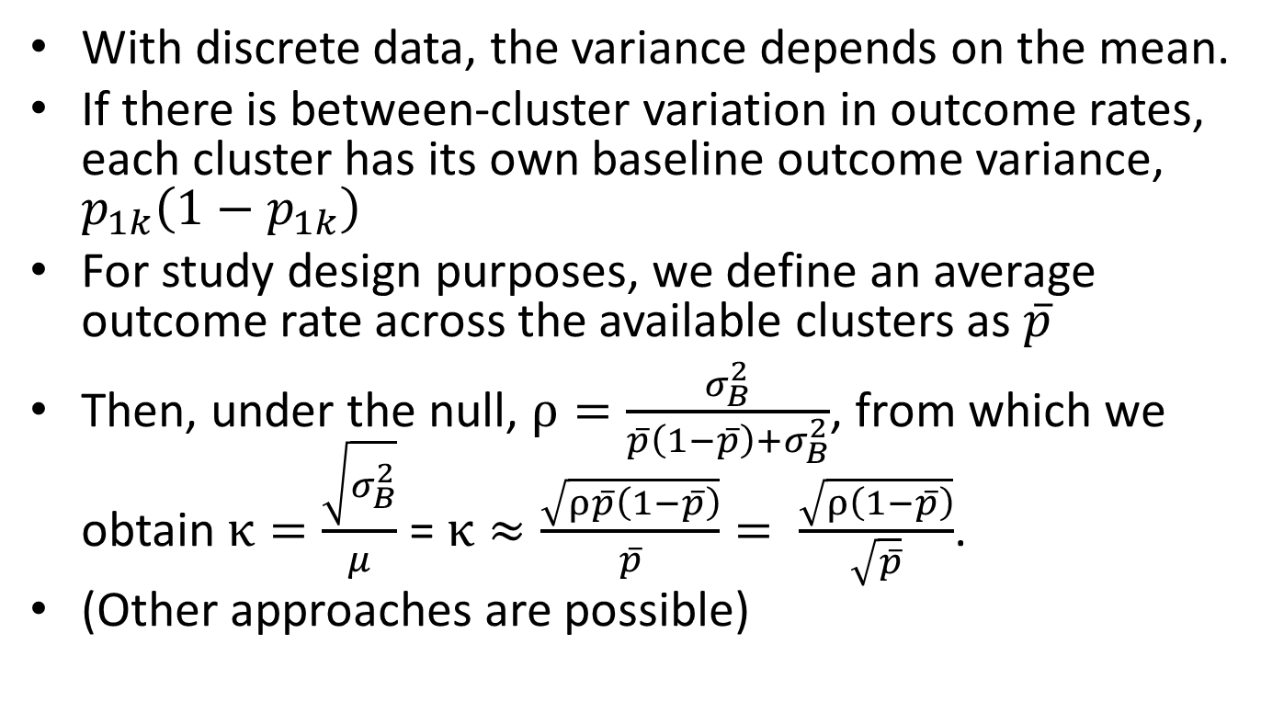
Relationship between ICC (ρ) and CV (κ)
With discrete data, the variance depends on the mean.
If there is between-cluster variation in outcome rates, each cluster has its own baseline outcome variance, $p_{1k}\left(1−p_{1k}\right)$
For study design purposes, we define an average outcome rate across the available clusters as $\overline{p}$
Then, under the null, $ρ=\frac{σ_{B}^{2}}{\overline{p}\left(1−\overline{p}\right)+σ_{B}^{2}}$, from which we obtain $κ=\frac{\sqrt{σ_{B}^{2}}}{μ}$ = $κ≈\frac{\sqrt{ρ\overline{p}\left(1−\overline{p}\right)}}{\overline{p}}= \frac{\sqrt{ρ\left(1−\overline{p}\right)}}{\sqrt{\overline{p}}}$.
(Other approaches are possible)

Slide 13
SWD power calculation software
Hussey MA, Hughes JP. Design and Analysis of Stepped Wedge Cluster Randomized Trials. Contemporary Clinical Trials, 28:182-191, 2007.
excel spreadsheet for SW power calculations (proportions)
http://faculty.washington.edu/jphughes/Power%20for%2
0stepped%20wedge.xls
excel spreadsheet for SW power calculations (means)
http://faculty.washington.edu/jphughes/Power%20for%20stepped%20wedge%20(mean).xls

Slide 14
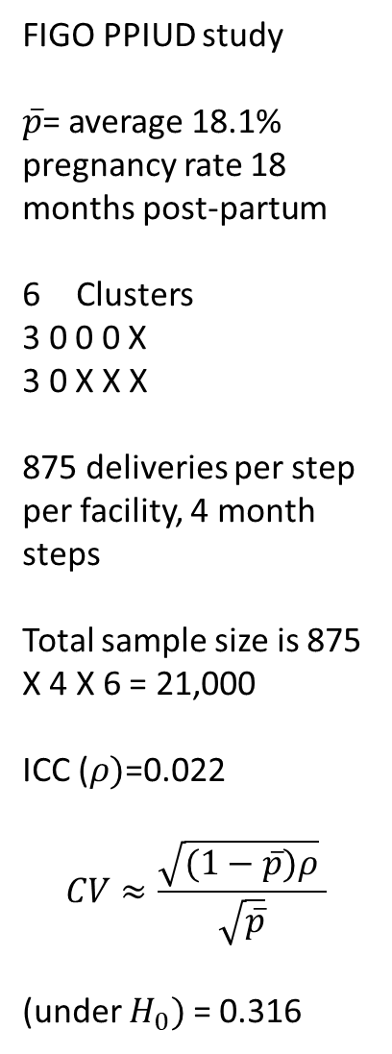
FIGO PPIUD study
$\overline{p}$= average 18.1% pregnancy rate 18 months post-partum
Clusters
3 0 0 0 X
3 0 X X X
875 deliveries per step per facility, 4 month steps
Total sample size is 875 X 4 X 6 = 21,000
ICC ($ρ)$=0.022
$$CV≈\frac{\sqrt{(1−\overline{p})ρ} }{\sqrt{\overline{p}}}$$
(under $H_{0})$ = 0.316

Slide 15
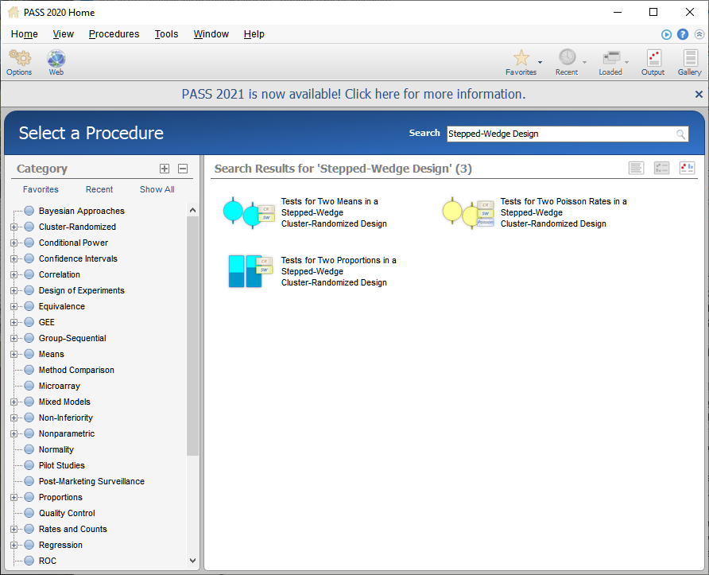

Slide 16
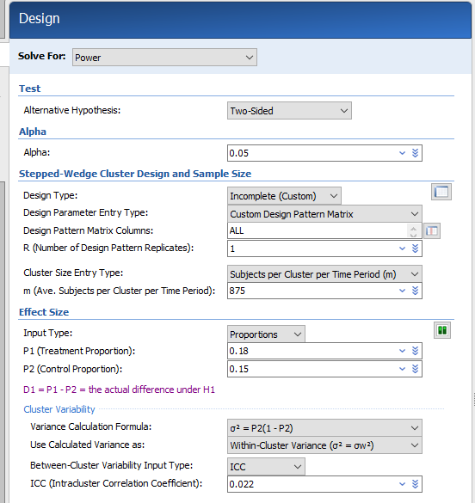
In a complete stepped-wedge designs, clusters sequentially switch from control to treatment in a balanced fashion over a fixed number of time points (T). Once a cluster switches from control to treatment, the cluster continues to receive the treatment for the duration of the study. The number of clusters (K) is equal to number steps (S (our T-1)) multiplied by the number of clusters switching at each step (R), K = S × R.
From PASS documentation

Slide 17
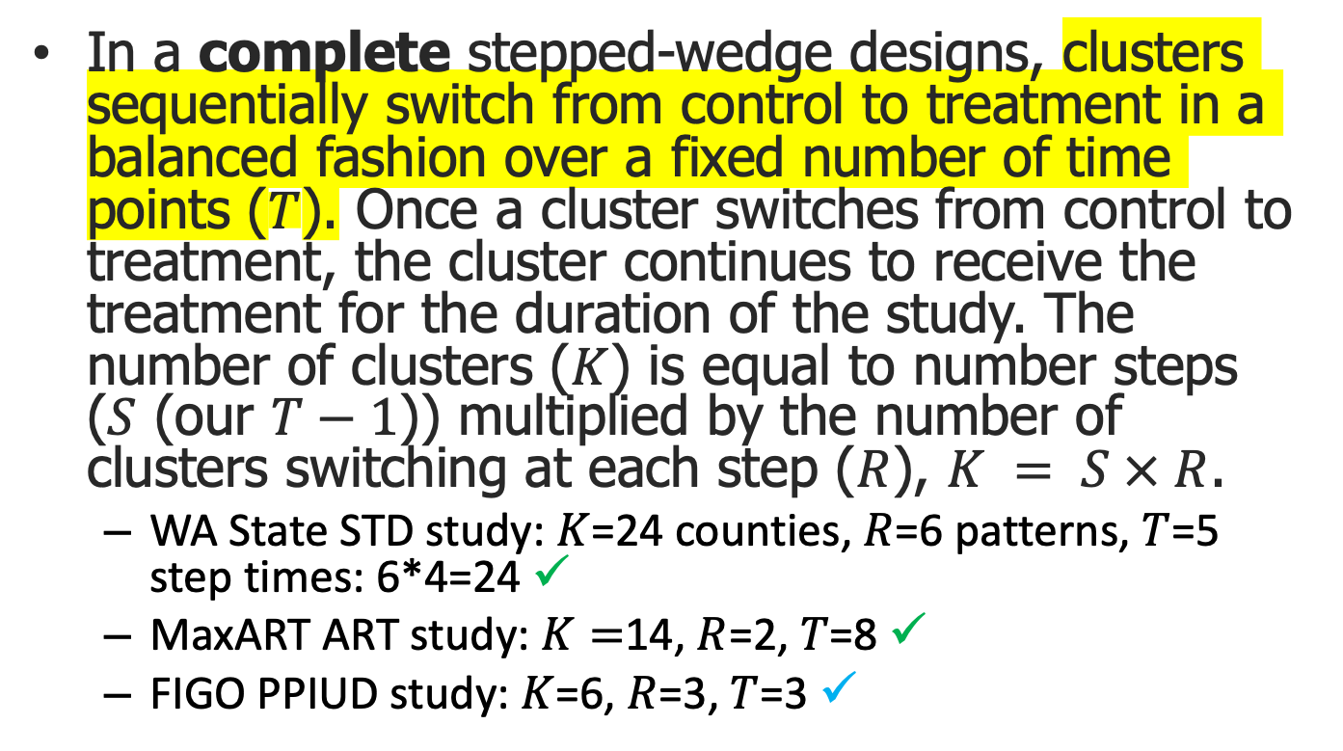
Complete vs Incomplete SWD
In a complete stepped-wedge designs, clusters sequentially switch from control to treatment in a balanced fashion over a fixed number of time points ($T$). Once a cluster switches from control to treatment, the cluster continues to receive the treatment for the duration of the study. The number of clusters ($K$) is equal to number steps ($S$ (our $T−1$)) multiplied by the number of clusters switching at each step ($R$), $K = S × R$.
  WA State STD study: $K$=24 counties, $R$=6 patterns, $T$=5 step times: 6*4=24 ✓
  MaxART ART study: $K=$14, $R$=2, $T$=8 ✓
  FIGO PPIUD study: $K$=6, $R$=3, $T$=3 ✓

Slide 18
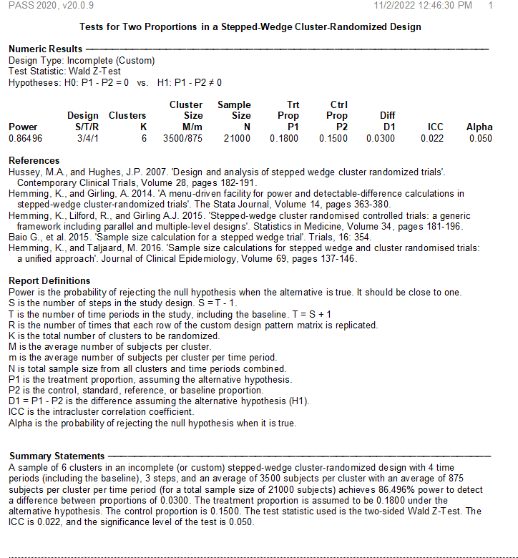

Slide 19


